Slide 1
CS 599:MARIO KART BOT

Slide 2
Objective
Convolutional Neural Networks and Reinforcement Learning techniques will be used to build an agent that will be able to navigate through certain tracks in the game and use the special powers provided to the characters to eventually win the race.

Slide 3
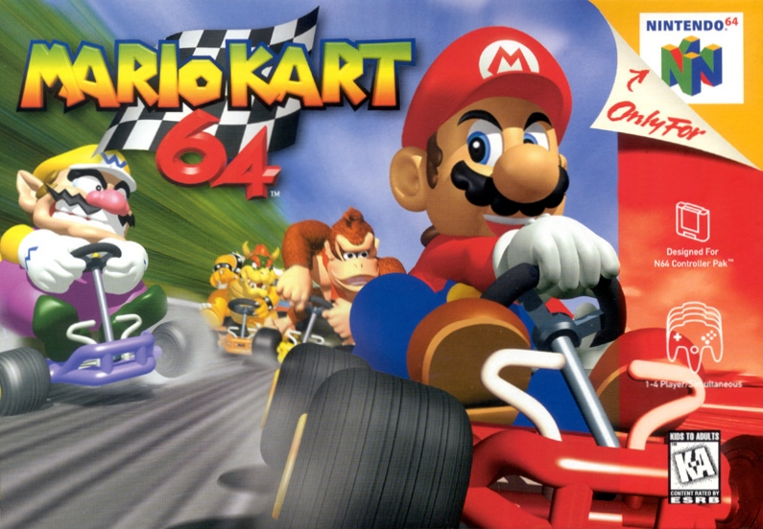
SUPER MARIO KART
Racing Game
Special power ups during the race
Multiple characters to choos from

Slide 4
Previous Work
Imitation Learning:
- Popular technique for training real-time deep learning controllers.
- Form of supervised learning
- An expert is recorded performing the task, and observations and resulting actions are recorded at each time-step.
- Subject to distribution mismatch problems.

Slide 5
Previous Work
Reinforcement Learning
- Reinforcement learning requires no human input at all.
- AI repeatedly tries to execute runs, some of which will be more successful than others.
- Reinforcement learning is more complicated and takes longer to converge but is less susceptible to distribution mismatch problems.

Slide 6
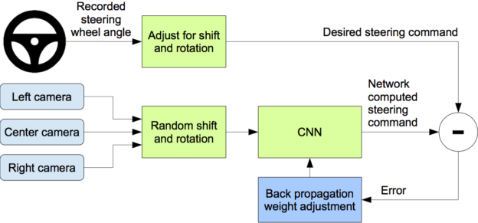
NVIDIA Model

Slide 7
COMPONENTS
Bizhawk Emulator
Used for saving/loads states, access in-game memory locations etc.
Search AI
Used to get data for training.
This includes a frame from different angles and the corresponding steering angle
CNN
Used NVIDIA autopilot model.
Interface to run Lua scripts while playing Mario Kart
Used pre-processing techniques like resizing, data-augmentation and gaussian blur to smoothen the image.
DAgger Algorithm
.As error accumulates fast in a trajectory, the AI agent slowly might drift off the road and needs to be corrected.
This is the solution to recover from error states
Real-time Play!
A TCP-IP server that loads the Keras model and play the game in real time.
Screen shots are sent over the server, the steering angel is predicted by the model and the joy stick value is set.

Slide 8
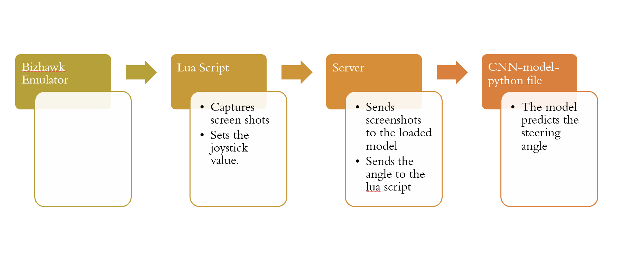
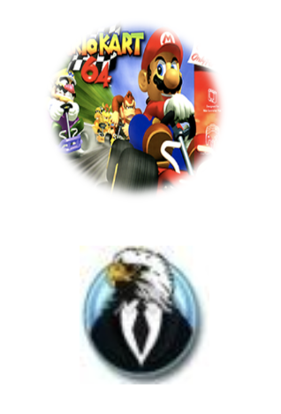
MODEL PIPELINE

Slide 9
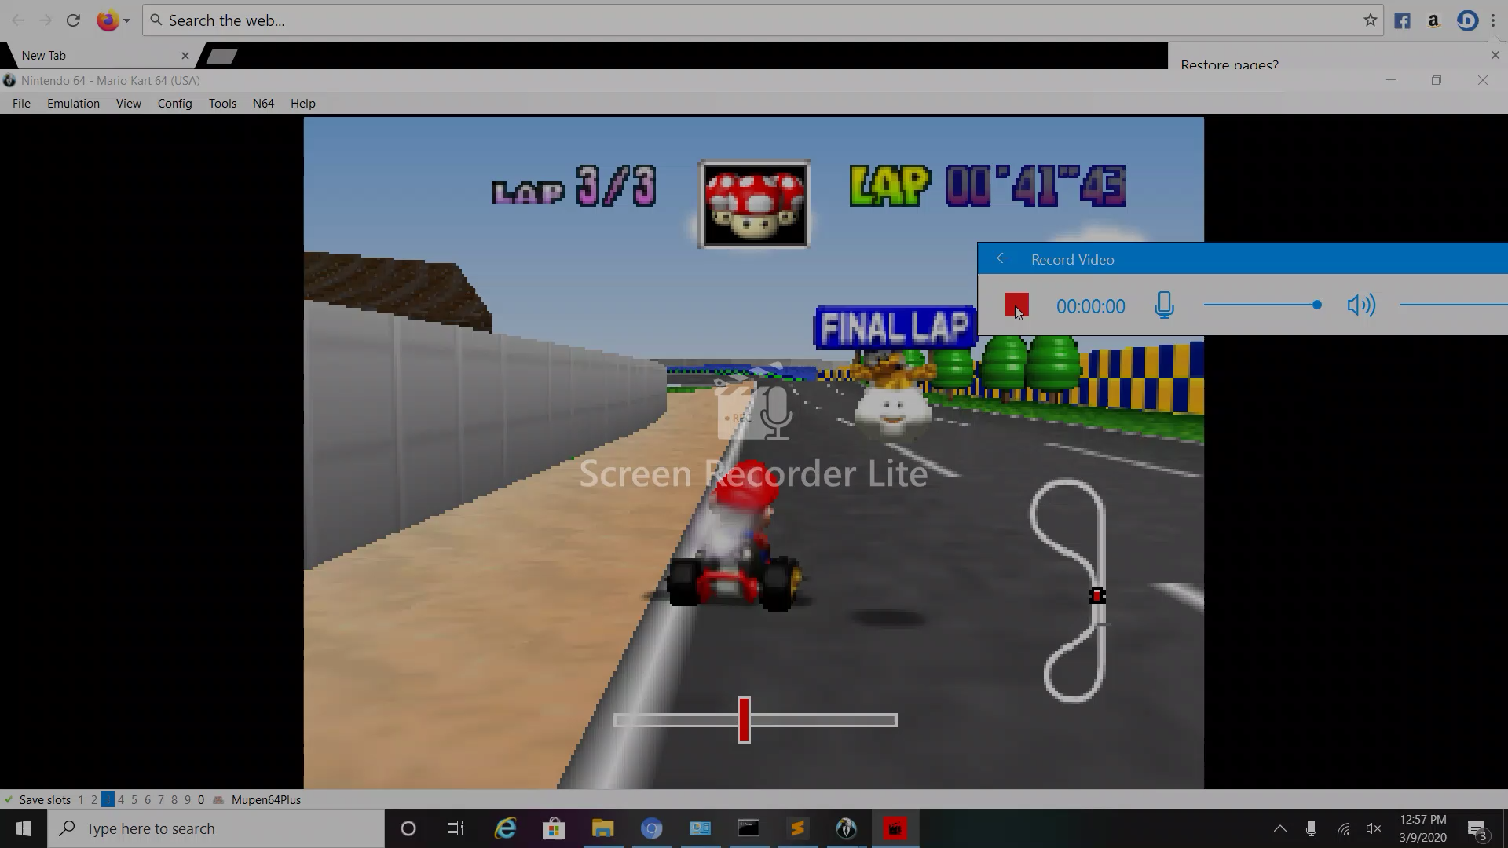

Slide 10
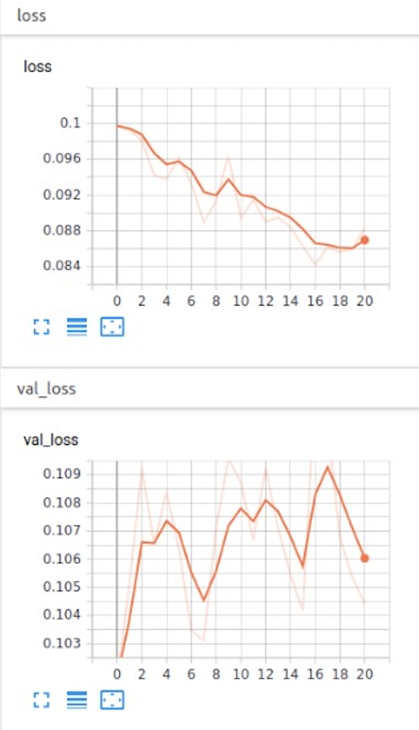
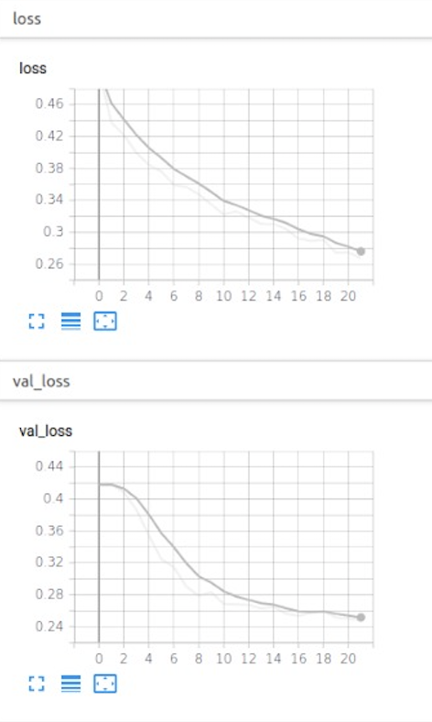
Training

Slide 11
Future Work- RL based Agent
The objective of this project is to develop a game playing agent for Super Mario Kart using different Machine Learning techniques.
Convolutional Neural Networks and Reinforcement Learning techniques will be used to build an agent that will be able to navigate through certain tracks in the game and use the special powers provided to the characters to eventually win the race.
CNN by itself is well equipped to navigate through tracks efficiently. The use of RL comes handy to provide the agent capabilities to use the power ups available to the characters at “appropriate” moments to win the race.

Slide 12
To DO
Computer Vision network for feature extraction
CV for power boost detection
Modeling feature extracted from CV network and object detected from the frames in a fused feature input
Modeling Gym environment with a RL network (AC or PPO)
Designing Reward Function
Training Vision network for RL
Training end-to-end CV-RL pipeline

Slide 13
References
S. Schaal. Is imitation learning the route to humanoid robots? Trends in cognitive sciences, 3(6):233–242, 1999.
Harrison Ho, Varun Ramesh, Eduardo Torres Montano˜ NeuralKart: A Real-Time Mario Kart 64 AI
S. Ross, G. J. Gordon, and D. Bagnell. A reduction of imitation learning and structured prediction to no-regret online learning. In AISTATS, volume 1, page 6, 2011.
M. G. Bellemare, Y. Naddaf, J. Veness, and M. Bowling. The arcade learning environment: An evaluation platform for general agents. Journal of Artificial Intelligence Research, 47:253–279, 06 2013.
What we’re driving at. https:// googleblog.blogspot.com/2010/10/ what-were-driving-at.html. Accessed: 2017-06- 12.
J. Levinson, J. Askeland, J. Becker, J. Dolson, D. Held, S. Kammel, J. Z. Kolter, D. Langer, O. Pink, V. Pratt, M. Sokolsky, G. Stanek, D. Stavens, A. Teichman, M. Werling, and S. Thrun. Towards fully autonomous driving: systems and algorithms. In Intelligent Vehicles Symposium (IV), 2011 IEEE, 2011.
M. Bojarski, D. Del Testa, D. Dworakowski, B. Firner, B. Flepp, P. Goyal, L. D. Jackel, M. Monfort, U. Muller, J. Zhang, et al. End to end learning for self-driving cars. arXiv preprint arXiv:1604.07316, 2016.
Mariusz Bojarski, Ben Firner, Beat Flepp, Larry Jackel, Urs Muller, Karol Zieba and Davide Del Testa, https://devblogs.nvidia.com/deep-learning-self-driving-cars/
Tensorkart: self-driving mariokart with tensorflow. http://kevinhughes.ca/blog/tensor-kart. Accessed: 2017-05-01.
https://medium.com/@jonathan_hui/rl-imitation-learning-ac28116c02fc

Slide 14
THANK YOU!

